Slide 1
For instructors
Code Afrique Team

Slide 2
Philosophy
Means: students should play (try it out). Mentors should help out.
This is a Python course to be completed in 1.5 days
Relate to what they already know
They know functions: start with functions
Don’t introduce things until they need them
Don’t teach more than students need for the programming contest problems
Except perhaps print/input, because (some think) it’s fun

Slide 3
Outline and approximate schedule
Defining functions (and using Spyder)
Errors / bugs
Strings
Lists
Variables
Loop (“stylized” for loops only)
Ranges (with 2 arguments only)
If statements
Functions calling functions
How to solve a programming problem
Input/Output (optional)
Day 1, morning
Day 1, afternoon
Day 2, morning

Slide 4
Eliminated
Booleans, and, or, not, …
String escaping, single quoted strings, string slicing, negative indexing
Compound assignment operators like +=, -=
Object orientation, methods (everything is functional now)
Mutable data structures, arrays
Ranges except range(start, end)
Data type discussion
“Laundry lists” (i.e., operators)
External libraries
Elif
While loops
Infinite loop interruption
Comments (except commenting out functions)

Slide 5
We are teaching a subset of Python
Pretend Python is (mostly) a functional language
Functions have ”input parameters” or “arguments”
Input parameters are *not* variables---they are constants
Lists and strings are also constants---you can’t change them
You can’t even append to them!
The only thing that can be mutated is a variable
No object-orientation whatsoever
Pretend range() has exactly two arguments

Slide 6
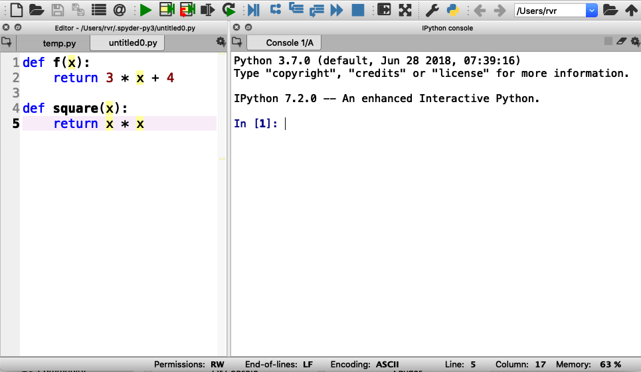
Setting up Spyder
Set it up with an edit box on the left and a console on the right
Like so:
Spyder can be downloaded as part of Anaconda from https://www.anaconda.com/distribution/

Slide 7
Using Spyder
In the edit box on the left, we only define functions
We will not use the left box for anything else
Hitting the green triangle compiles these functions
In the box on the right (the “console”), we run functions

Slide 8
Intro
To
Python
Code Afrique Team

Slide 9
What is Python?
A language to tell a computer what to do
Computers are stupid---they need to be told EXACTLY what to do
There are many programming languages
Python is good for learning to program

Slide 10

Basic concept: Functions
For example:
$f\left(x\right)= 3x + 4$
$g\left(x\right)=$ $\sqrt{x}$
$sum\left(x, y\right)= x + y$
Notes:
Note that we’re starting with basic arithmetic functions that students are already familiar with

Slide 11

Basic concept: Functions
For example:
$f\left(x\right)= 3x + 4$
$g\left(x\right)=$ $\sqrt{x}$
$sum\left(x, y\right)= x + y$
$f$ is the name of this function

Slide 12
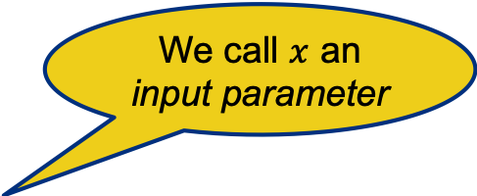
Basic concept: Functions
We call $x$ an input parameter
For example:
$f\left(x\right)= 3x + 4$
$g\left(x\right)=$ $\sqrt{x}$
$sum\left(x, y\right)= x + y$
$f$ is the name of this function

Slide 13
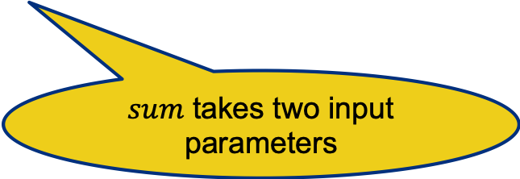
Basic concept: Functions
We call $x$ an input parameter
For example:
$f\left(x\right)= 3x + 4$
$g\left(x\right)=$ $\sqrt{x}$
$sum\left(x, y\right)= x + y$
$f$ is the name of this function
$sum$ takes two input parameters

Slide 14
Functions in Python
def f(x):
return 3 * x + 4
def square(x):
return x * x

Slide 15
Functions in Python
Function header
def f(x):
return 3 * x + 4
def square(x):
return x * x
Function header

Slide 16
Functions in Python
Function header
def f(x):
return 3 * x + 4
def square(x):
return x * x
Function body
Function header
Function body

Slide 17
What is Spyder?
An application to write Python programs and run them
Notes:
Everybody should do this. Wait for everybody to be done. Note that we only put function definitions in the left box and nothing else

Slide 18
Using Spyder
Step 1: Enter Python functions in this box
Notes:
Everybody should do this. Wait for everybody to be done. Note that we only put function definitions in the left box and nothing else

Slide 19
Using Spyder
Step 2: Click on the green triangle (don’t forget)

Slide 20
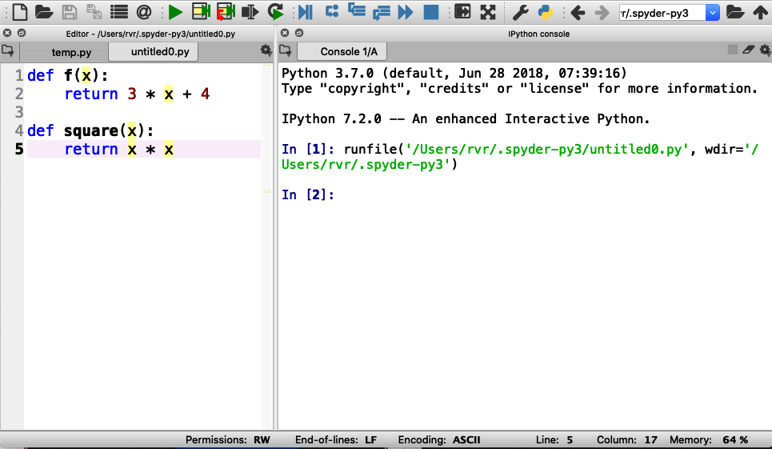
Using Spyder
Step 2: Click on the green triangle (don’t forget)
Output (and error messages) appear in “console” box

Slide 21

Using Spyder
Step 3: Type a function call here and hit “enter”

Slide 22
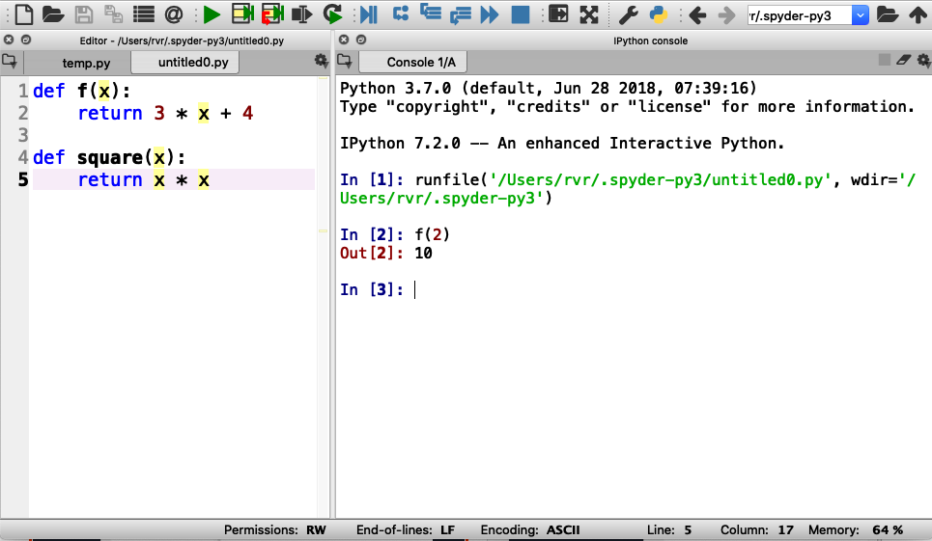
Using Spyder
Step 3: Type a function call here and hit “enter”
Result of function printed here
Notes:
After this, have them try other invocations of f() and square()

Slide 23

Try the following (and take turns!):
$f(0)$
$f(0.5)$
$f(−3)$
$square(−3)$
$square(123456789)$
$square(f(0))$

Slide 24
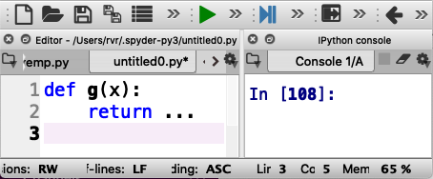

Now define functions yourself
Write the following function in Python :
$g\left(x\right)=x^{2}$ $+ 2x + 3$
Evaluate :
$g(0)$
$g(1)$
$g(−0.5)$
dot dot dot
Write your code here

Slide 25
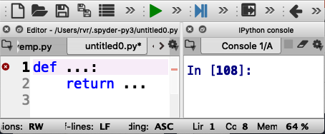

More time for you to play
Write a function $add\left(x, y,z\right)$ that returns the sum of its three inputs (that is, $x + y + z$)
Evaluate the following:
$add(1, 2, 3)$
$add(1, 1, −2)$

Slide 26
Errors and Bugs….
Remember: computers are stupid
Everything needs to be EXACTLY right

Slide 27
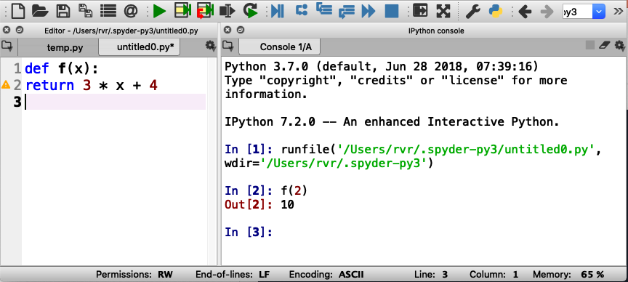
Indentation error
The function body
MUST BE indented

Slide 28
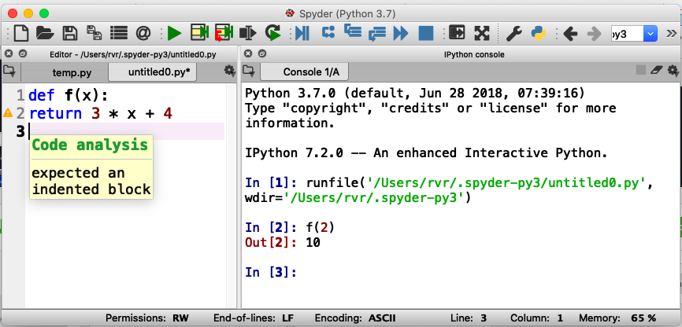
Indentation error
Hover mouse over triangle for information about the error

Slide 29
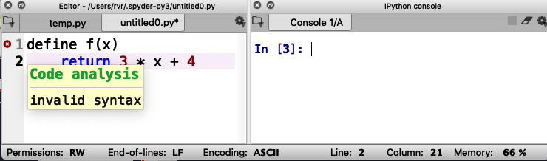
“syntax” error
Missing ”:” (colon)

Slide 30
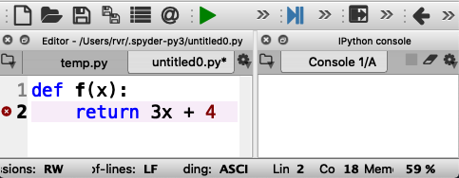
Another syntax error
Missing * between 3 and x

Slide 31
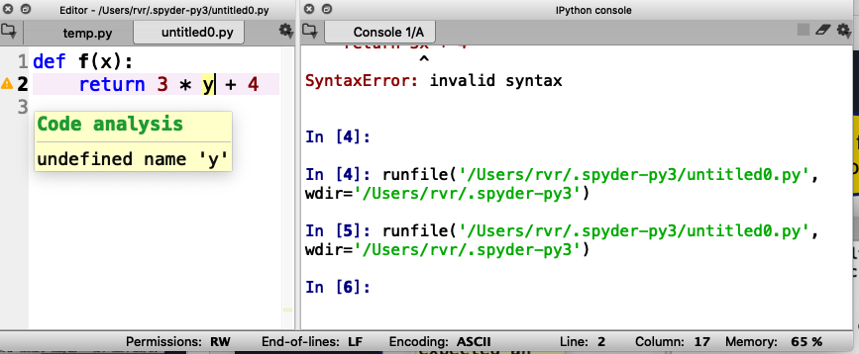
Undefined name warning
Should be ‘x’, not ‘y’

Slide 32
Remember: Keep hitting that green triangle
You need to do that each time you change or fix your code!

Slide 33
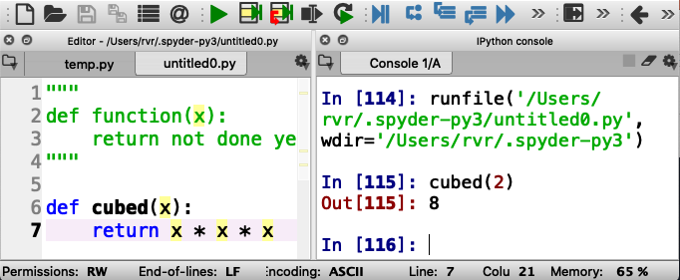
Tip: “commenting out functions”
If you want to save a function you are working on but it does not quite work yet, you can temporarily “comment it out”.
To do this, place three quotes before and after the function at the beginning of the line

Slide 34
What have we learned so far?
You can define functions in Python
In Spyder, you enter functions in the “left box” of Spyder
You can try out functions in the ”right box” of Spyder
You need to deal with errors to get things to work
You can comment out functions temporarily

Slide 35
“Strings”

Slide 36
Strings are fun!
Examples of strings: “hello” “I love Code Afrique” “fdalepru”
A string is enclosed in quotation marks (“)
You can glue together two strings using +
“hello, ” + “Jon” is “hello, Jon”
“abcd” + “efgh” is “abcdefgj”
“efgh” + “abcd” is “efghabcd”
Notes:
The last two examples are to show that + on strings does not commute
We’re not teaching string escaping or enclosing strings in single quotes or triple quotes at this time

Slide 37
Functions with strings
Write a function greet(x) that returns the string “hello, x”
Notes:
This is an example

Slide 38
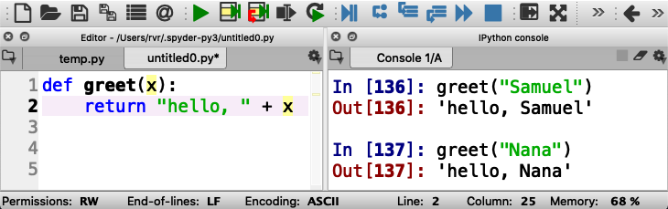
Functions with strings
Write a function greet(x) that returns the string “hello, x”
Notes:
Let the students try this out if you have time

Slide 39
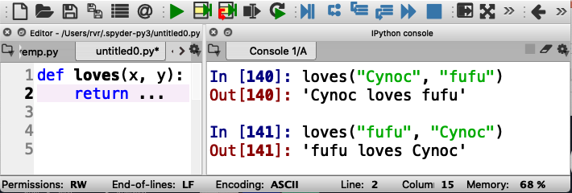
Now you try it (remember, take turns)
Write a function loves(x, y) that returns a string “x loves y”
dot dot dot
Write your code here
Be sure to test it here with different examples
(and take turns!)
Notes:
Solution: … = x + “ loves “ + y

Slide 40
String indexing
A position in a string is called an index
Indexes start counting at 0
Shoshana
01234567
The index of ‘o’ is 2

Slide 41
String indexing
Write a function firstTwoLetters(str)that returns the first two letters in the input string str
Notes:
Let students think for a second and realize that they can’t do it with what we taught already

Slide 42
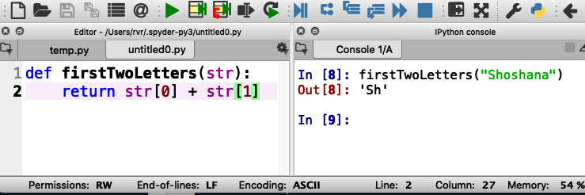
String indexing
Write a function firstTwoLetters(str)that returns the first two letters in the input string str
str[x] evaluates to the letter at index x
Notes:
Call out the square brackets

Slide 43
String indexing
Write a function firstTwoLetters(str)that returns the first two letters in the input string str
str[x] evaluates to the letter at index x
Do not confuse:
f(x) - call function f with
input parameter x
s[x] - get the letter at index x
from string s

Slide 44
Quiz
If a string has 10 letters, what is the index of the last letter?
9
10
11
Notes:
The correct answer is A: 9. indexes are between 0 and (length – 1)

Slide 45
Length of a string
Built-in function len(str) returns the length of string str
Examples:
len(“hello”) is 5
len(“Lesley Greene”) is 13
len(“”) is 0

Slide 46
Function using len(str)
Write a function lastLetter(str)that returns the last letter in the input string str
Notes:
Let students think for a second: they should know how to do this

Slide 47
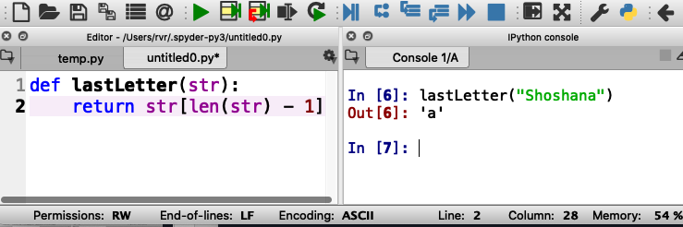
Function using len(str)
Write a function lastLetter(str)that returns the last letter in the input string str
Notes:
Let the students try it out

Slide 48
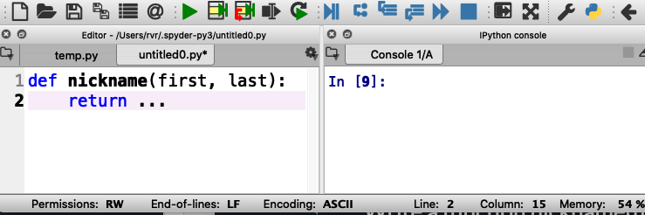
What is your Code Afrique nickname?
Write a function nickname(first, last)that consists of the first three letters of your given name (first name) followed by the last three letters of your surname (last name) , followed by “ca” (for Code Afrique)
For example: nickname(“Hakim”, “Weatherspoon”) is “Hakoonca”
Notes:
… = first[0] + first[1] + first[2] + last[len(last) – 3] + last[len(last) – 2] + last[len(last) – 1] + “ca”

Slide 49
What have we learned about strings?
A string is a list of letters, enclosed by quotes
We can glue two strings together with +
We can get the length of string s with the function len(s)
Letters in a string are indexed from 0
To get the letter of string s at index x, use s[x] (square brackets!)

Slide 50
Lists

Slide 51
Examples of lists
[ 1, -5, 3 ] a list of numbers
[ “dogs”, “cats” ] a list of strings
[] an empty list
[4] a list with one number

Slide 52
Examples of lists
Lists use “square brackets” [ ]
[ 1, -5, 3 ] a list of numbers
[ “dogs”, “cats” ] a list of strings
[] an empty list
[4] a list with one number

Slide 53
Examples of lists
Lists use “square brackets” [ ]
[ 1, -5, 3 ] a list of numbers
[ “dogs”, “cats” ] a list of strings
[] an empty list
[4] a list with one number
Fun fact: a string is a list of letters, and everything you can do with strings you can also do with other lists
For example:
len( [ “dogs”, “cats”, “mice” ] ) is 3
[ “dogs” ] + [ “cats ] is [ “dogs”, “cats” ]

Slide 54
Example function with lists
Write a function addToList(Lst, x) that returns a new list consisting of Lst and x
For example addToList([ “apples”, “juice” ], “milk”) becomes [ “apples”, “juice”, “milk” ]
Notes:
Let students think about how to do this for a second

Slide 55
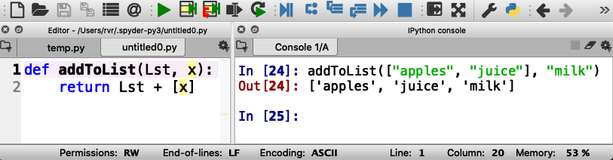
Example function with lists
Write a function addToList(Lst, x) that returns a new list consisting of Lst and x
For example addToList([ “apples”, “juice” ], “milk”) becomes [ “apples”, “juice”, “milk” ]

Slide 56
Example function with lists
Write a function addToList(Lst, x) that returns a new list consisting of Lst and x
For example addToList([ “apples”, “juice” ], “milk”) becomes [ “apples”, “juice”, “milk” ]
List consisting of x
(just one element)

Slide 57
Try it out (and take turns!)
Notes:
Have students type this in and try out other examples

Slide 58
What have we learned about lists?
You can put anything in a list
They are much like strings
We can glue two lists together with +
We can get the number of elements in list Lst using len(Lst)
Elements of a list are indexed from 0
To get the element of string Lst at index x, use Lst[x]

Slide 59
Variables

Slide 60
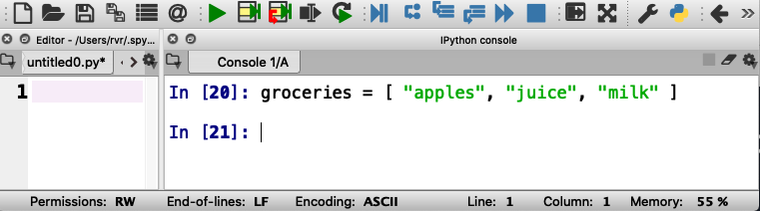
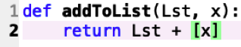
How to keep a shopping list?
groceries is a “variable”
Variables remember values so you can use them later
Notes:
Note that this is entered in the Spyder box on the right, not the left

Slide 61
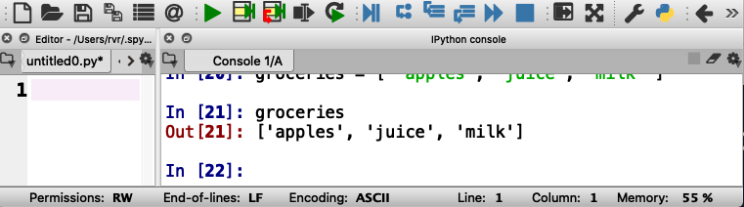
How to keep a shopping list?
Python can recall the value of groceries
Notes:
You may want to have students play with this before moving on

Slide 62
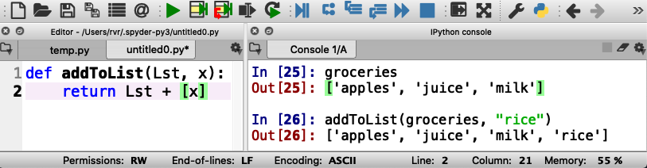
Example: adding “rice” to the shopping list
Does it work?
Notes:
You may want to have students type in the code and try out the example

Slide 63
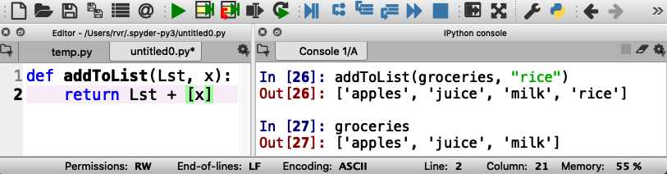
Example: adding “rice” to the shopping list
The value of groceries has not changed…
(because we didn’t tell Python to do that)

Slide 64
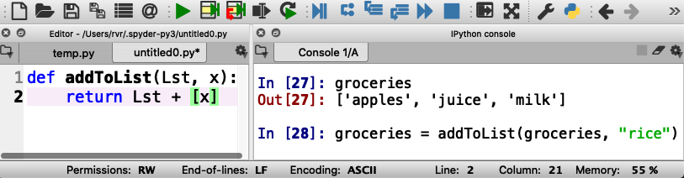
Example: adding “rice” to the shopping list
Here we tell Python to store a new value for groceries

Slide 65
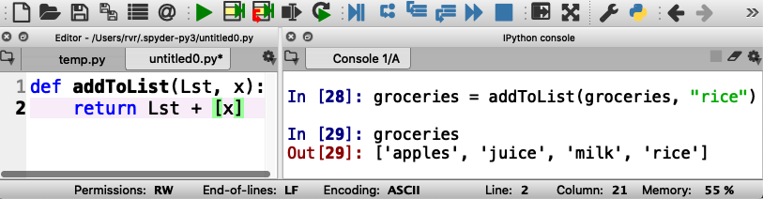
Example: adding “rice” to the shopping list
Now “rice” is in groceries

Slide 66
Example: adding “rice” to the shopping list
Now practice adding some more items to groceries
Notes:
Give the students time to practice

Slide 67
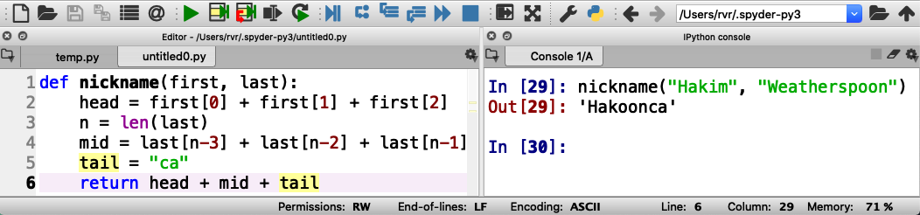
Using variables inside a function
You can use a variable to store and use an intermediate value
For example:
Notes:
this is the first time we introduce a “multi-line” function

Slide 68
Make sure you get the indentation right!
All these lines must be indented the same way!
Notes:
you may want to let students try out this function

Slide 69
What have we learned about variables?
Each variable has a name
You can store any value in a variable
The notation for this in Python is x = value
You can change the value of a variable the same way

Slide 70

Loops

Slide 71
Doing something with each element of a list
Write a function product(Lst) that returns the product of all elements in a list of numbers
How would you do this writing on a piece of paper?
Notes:
Let students think about this for a while. Ask them

Slide 72
Doing something with each element of a list
Write a function product(Lst) that returns the product of all elements in a list of numbers
How would you do this writing on a piece of paper?
Start with the first number

Slide 73
Doing something with each element of a list
Write a function product(Lst) that returns the product of all elements in a list of numbers
How would you do this writing on a piece of paper?
Start with the first number
Multiply with the next number

Slide 74
Doing something with each element of a list
Write a function product(Lst) that returns the product of all elements in a list of numbers
How would you do this writing on a piece of paper?
Start with the first number
Multiply with the next number
Repeat until done with all numbers

Slide 75
Doing something with each element of a list
Write a function product(Lst) that returns the product of all elements in a list of numbers
How would you do this writing on a piece of paper?
Start with the first number
Multiply with the next number
Repeat until done with all numbers
This is called a “loop”

Slide 76
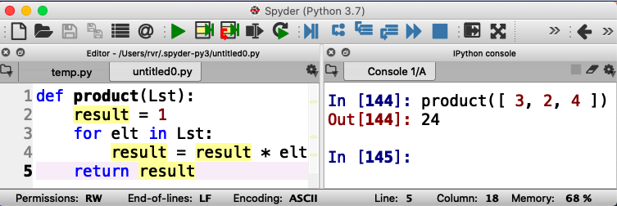
Loops in Python

Slide 77
Loops in Python
result is a variable

Slide 78
Loops in Python
result is a variable
elt is an element in Lst

Slide 79
Loops in Python
result is a variable
elt is an element in Lst
result is updated for each element

Slide 80
Loops in Python
result is a variable
elt is an element in Lst
result is updated for each element
Here, result is 1 * 3 * 2 * 4
Notes:
Don’t really need to let students try this, but you could if you like to
For mentors (and possibly students) who think there is a bug: product([]) == 1 is correct. After all, product (X+Y) == product(X) * product(Y) and X + [] == X. Therefore product(X) == product(X + []) == product(X) * product([]) for arbitrary X. Therefore product([]) == 1. This is in fact the reason why in product() we initialize result to 1, the unity element for multiplicative groups, and in sum() we initialize result to 0, the unity element for additive groups.

Slide 81
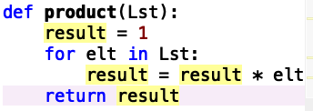
Executing a loop
elt
product([ 3, 2, 4 ])
elt
old result
new result
3
1
???

Slide 82
Executing a loop
elt
product([ 3, 2, 4 ])
elt
old result
new result
3
1
3

Slide 83
Executing a loop
elt
product([ 3, 2, 4 ])
elt
old result
new result
3
1
3
2
3
???

Slide 84
Executing a loop
elt
product([ 3, 2, 4 ])
elt
old result
new result
3
1
3
2
3
6

Slide 85
Executing a loop
elt
product([ 3, 2, 4 ])
elt
old result
new result
3
1
3
2
3
6
4
6
???

Slide 86
Executing a loop
elt
product([ 3, 2, 4 ])
elt
old result
new result
3
1
3
2
3
6
4
6
24

Slide 87
Executing a loop
product([ 3, 2, 4 ])
elt
old result
new result
3
1
3
2
3
6
4
6
24
The final result of the function

Slide 88

Write your own: below change product to sum That is, add all the items in the list together
Notes:
Do let students try this out. Make sure they try multiple inputs.

Slide 89
Example: write a function reverse(Lst) that reverses the elements in a list
For example: reverse([ 2, 5, 3 ]) should return [ 3, 5, 2 ]
Notes:
Let them think about it. In theory they have all the tools to solve it, but it’s a little tricky.

Slide 90
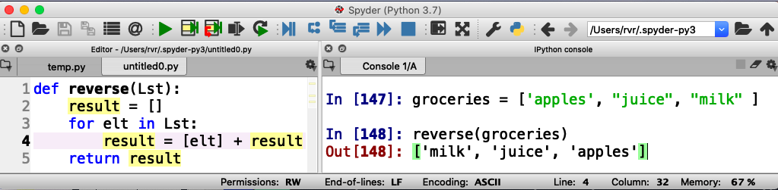
Example: write a function reverse(Lst) that reverses the elements in a list
Notes:
This might be a good thing to let them try out

Slide 91
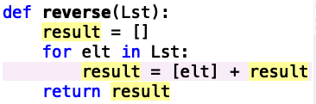
reverse([ “apples”, “juice”, “milk” ])
elt
elt
old result
new result
“apples”
[ ]
???

Slide 92
reverse([ “apples”, “juice”, “milk” ])
elt
elt
old result
new result
“apples”
[ ]
[ “apples” ]

Slide 93
reverse([ “apples”, “juice”, “milk” ])
elt
elt
old result
new result
“apples”
[ ]
[ “apples” ]
“juice”
[ “apples” ]
???

Slide 94
reverse([ “apples”, “juice”, “milk” ])
elt
elt
old result
new result
“apples”
[ ]
[ “apples” ]
“juice”
[ “apples” ]
[ “juice”, “apples” ]

Slide 95
reverse([ “apples”, “juice”, “milk” ])
elt
elt
old result
new result
“apples”
[ ]
[ “apples” ]
“juice”
[ “apples” ]
[ “juice”, “apples” ]
“milk”
[ “juice”, “apples” ]
???

Slide 96
reverse([ “apples”, “juice”, “milk” ])
elt
elt
old result
new result
“apples”
[ ]
[ “apples” ]
“juice”
[ “apples” ]
[ “juice”, “apples” ]
“milk”
[ “juice”, “apples” ]
[ “milk”, “juice”, “apples” ]

Slide 97
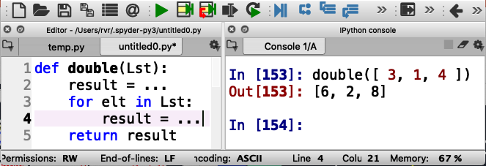
More practice with loops (remember: everybody gets a turn!)
Write a function double(Lst) that returns a list consisting of all the numbers in Lst, but then doubled
For example, double([ 3, 1, 4 ]) should return [ 6, 2, 8 ]
Notes:
Solution
the first … should be [ ] (the empty list)
the second … should be result + [ 2 * elt ]

Slide 98
Loops without lists
Write a function squares(start, end) that returns a list of all the squares of the numbers start (inclusive) through end (exclusive)
(in Computer Science, “inclusive” means that the value is included, and “exclusive” means that the value is excluded)
For example, squares(1, 10) should return
[ 1, 4, 9, 16, 25, 36, 49, 64, 81 ]

Slide 99
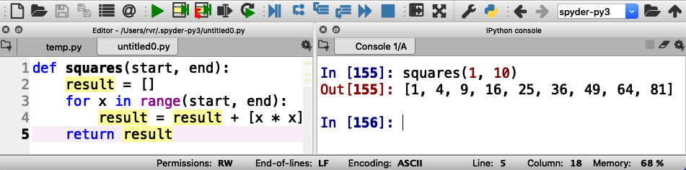
Using range(start, end)
range(start, end) generates the integers from start (inclusive) to end (exclusive)

Slide 100
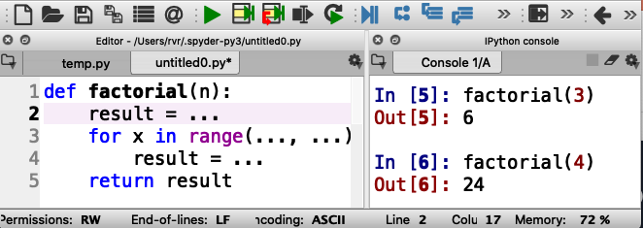
Your turn to practice with ranges
Write function factorial(n) that returns n!
n! is defined to be the product of all the integers from 1 to n
For example, factorial(3) is equal to 1 * 2 * 3 (that is, 6)

Slide 101
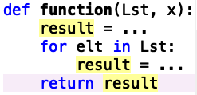
What have we learned about loops?
You can use a loop to visit every element in a list (or string)
Alternatively, you can use a loop to visit over a range
range(start, end) includes start but not end
Generic format of a function with a loop:
The type of the result should be the same as what the function returns. So if the function returns a number, then … should be a number. If it’s a string, then … should be a string.

Slide 102

IF STATEMENTS

Slide 103
What if you want to do something only sometimes?
Write function feeling(temp) that returns “cold” if temp < 20 or “hot” otherwise

Slide 104
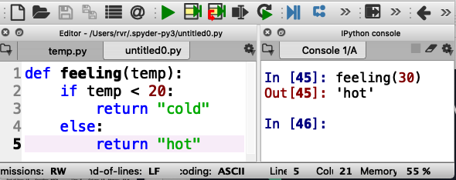
What if you want to do something only sometimes?
Write function feeling(temp) that returns “cold” if temp < 20 or “hot” otherwise

Slide 105
Correct indentation is important!

Slide 106
Using if statements in for loops
Write a function delete(Lst, item) that returns a list consisting of the elements of Lst except for item

Slide 107
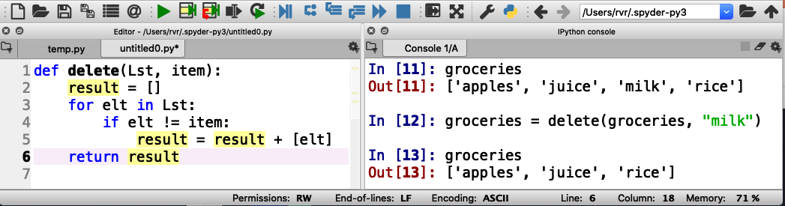
Using if statements in for loops
Write a function delete(Lst, item) that returns a list consisting of the elements of Lst except for item
!= means “is not the same as”

Slide 108
Testing for equality
== is used to check if two values are the same
(do not confuse with =, which is used to assign a value to a variable!)
For example: if elt == x:
. . .

Slide 109
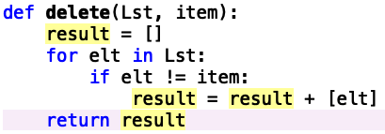
Correct indentation

Slide 110
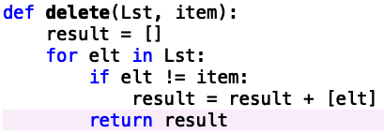
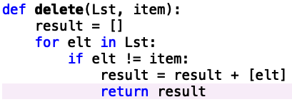
Incorrect indentations: what do these do?

Slide 111
Incorrect indentations: what do these do?
This returns after the first element in Lst
This returns after the first element that is not item
Notes:
Also, doesn’t return anything if the list is empty

Slide 112
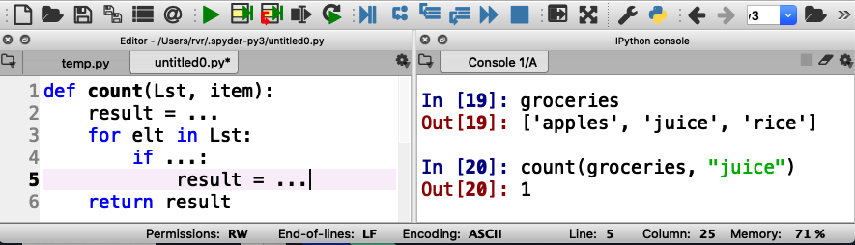
Your turn to practice
Write a function count(Lst, item) that counts how many times item occurs in Lst
For example, count([“apples”, “juice”, “apples”], “apples”) should return 2

Slide 113
What have we learned about if statements?
You can use an if statement to execute code based on a condition
An if statement may have an “else” part (but not required)
You have to indent code just so
You can use != to test if two values are different
You can use == to test if two values are the same
Do not confuse == and =
By the way, == and != work on numbers, strings, and even lists
For example: [ 1, 2, 3 + 4 ] == [ 1, 1 + 1, 7 ]

Slide 114
Programs with multiple functions

Slide 115
How to write difficult programs
Split program into multiple functions!
Write a function shop(Lst, item) that returns the string “we have item” if item is in Lst, or
“we need item” if not
For example: shop(groceries, “rice”) returns
“we have rice” if ”rice” is in groceries
Notes:
Multiple functions?

Slide 116
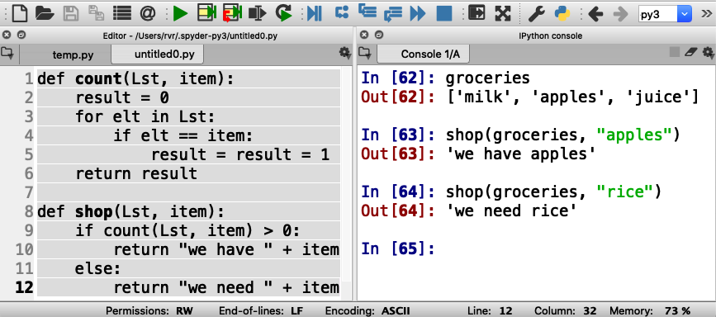
How to write difficult programs
Split program into multiple functions!
Write a function shop(Lst, item) that returns the string “we have item” if item is in Lst, or “we need item” if not

Slide 117
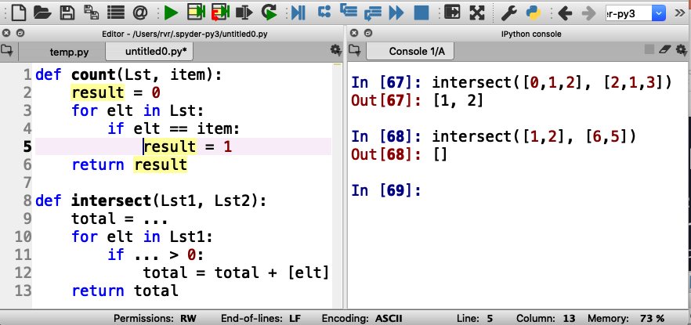
Practice writing a difficult program
Write a function intersect(Lst1, Lst2) that returns the intersection of lists Lst1 and Lst2 (a list of the elements that are in both lists).
You can again use the count(list, item) function to simplify the task

Slide 118
Just a little math before we go on

Slide 119
Two types of numbers
“integers”
Examples: 0, 1, 2, 3, -3, 93723881
”floating point numbers”
Examples: 3.14159, -0.05, 123.45

Slide 120
Division with integers and floating point numbers
What is 9 divided by 4?
Using integers, it is 2 with a remainder of 1
Using floating point numbers, it is 2.25

Slide 121
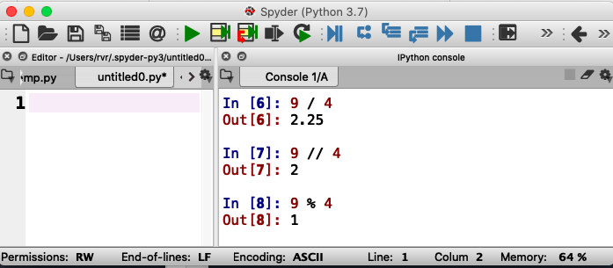
Same thing in Python
Floating point division
Integer division
Integer remainder (modulo)
You say “9 modulo 4”

Slide 122
Approaching Coding Questions

Slide 123
A 3-Step Approach To Coding Problems
Read the question carefully. Understand what information you have available to you and what the question wants you to do.
Try to write out an algorithm or solution to the problem in “English” or “pseudocode”.
Translate your English solution to code

Slide 124
Example
Q: Write a function oddOrEven(x) that returns “even” if x is even and “odd” if not

Slide 125
Step 1: Read the question carefully
Q: Write a function oddOrEven(x) that returns “even” if x is even and “odd” if not
After reading the question, we see that we have one integer number as our only input.
Since our function only has one input, our function header will look something like:
def oddOrEven(x):

Slide 126
Step 2: Design a solution in “English”
Q: Write a function oddOrEven(x) that returns “even” if x is even and “odd” if not
If the input parameter is divisible by 2, then we know it is even
Otherwise, it must be odd
We also know that we can check if something is divisible with the modulo operator, %

Slide 127
Step 3: translate English into code
If the input parameter is divisible by 2, then it is even
if num % 2 == 0:
return “even”
Otherwise, it must be odd
else:
return “odd”

Slide 128
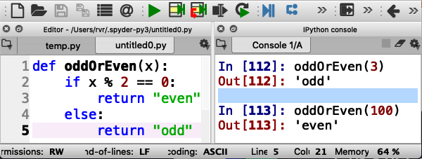
Finally, test it out
Test carefully!

Slide 129
Time to practice
Write a function isPrime(n) that returns
“yes” if n is prime and “no” otherwise
In English: a number n is prime if it can only be divided by 1 and itself
(1 is an exception: it is not considered prime)
So, try to divide n by all numbers between 2 and n-1 and make sure there is always a non-zero remainder

Slide 130
A primer on conversion
Notes:
We need to do this before we can talk about I/O. But if we skip I/O, we may also want to skip this

Slide 131
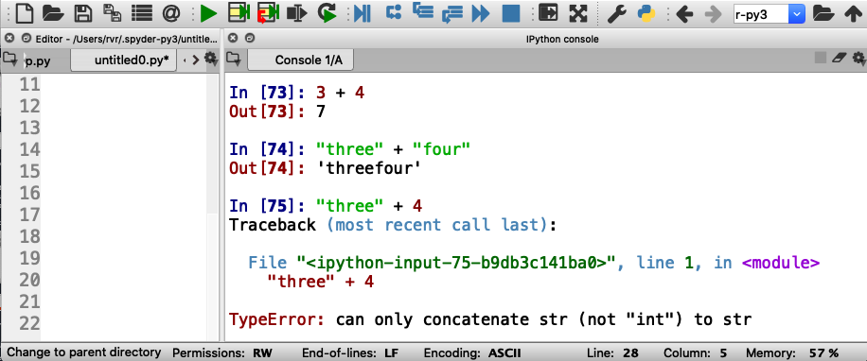
Strings and Numbers
3 + 4 == 7
“three” + “four” == “threefour”
What is ”three” + 4???

Slide 132
Strings and Numbers
3 + 4 == 7
“three” + “four” == “threefour”
What is ”three” + 4?

Slide 133
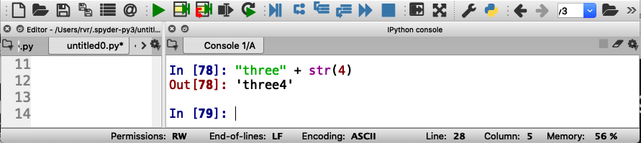
Converting integers to strings
str(4) is the string “4”

Slide 134
Input/Output
Notes:
Input/Output is probably something we should not teach at all. It’s confusing. Of course, it is fun to run programs that do I/O, but actually programming it is boring stuff and probably a waste of time for a 2-day course.

Slide 135
Python functions can “print” (output) and read from the keyboard or even files (input)
Write a function needToShop(Lst) that asks for the name of an item and prints the item and how many instances of the item are in Lst
Note: the item is not an input parameter to needToShop(Lst)

Slide 136
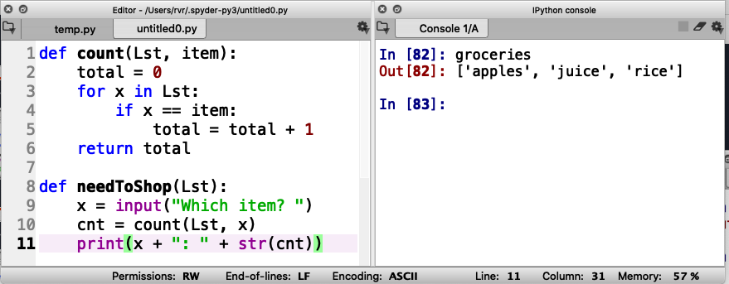
Function needToShop(Lst)

Slide 137
Function needToShop(Lst)
Read input

Slide 138
Function needToShop(Lst)
Read input
Write output

Slide 139
Function needToShop(Lst)
Read input
Write output
Note integer to string conversion

Slide 140
Function needToShop(Lst)
Read input
Write output
no return statement

Slide 141
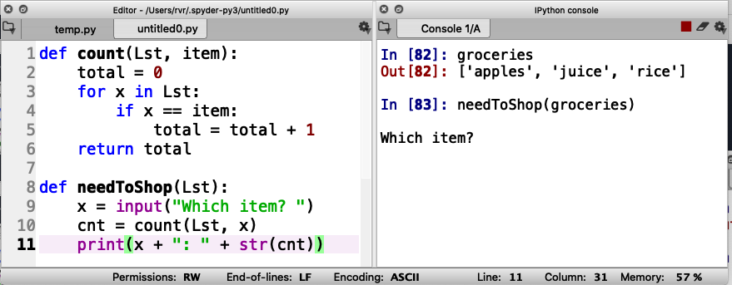
Function needToShop(Lst)
Call function here
Read input
Write output

Slide 142
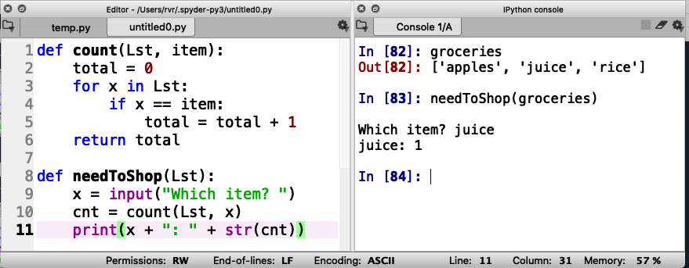
Function needToShop(Lst)
Call function here
Read input
Enter input here
Write output

Slide 143
Give it a shot yourself (and take turns!)

Slide 144

Input/Output in a loop
How to ask for input over and over again?

Slide 145
Input/Output in a loop
How to ask for input over and over again?
Long loop

Slide 146
Input/Output in a loop
How to ask for input over and over again?
Long loop
Add a way to stop

Slide 147
Input/Output in a loop
How to ask for input over and over again?
Long loop
Add a way to stop
Return to break out of this function

Slide 148
Try it out

Slide 149

Write your own I/O function
Write a function that, in a loop, reads a string and prints the length of the string and the total length of all the strings that were input. Stop if the input is the empty string (“”).
Recall that len(str) returns the length of string str

Slide 150
What have we learned about input/output
You can print values using the print(value) statement
You can input values using the input(prompt) statement (where prompt is a string that is printed to ask the user for input)

Slide 151
Bonus: functions with multiple return results

Slide 152
Write a function split(Lst, pivot) that returns a list containing all values in Lst that are less than pivot and another list that returns all values in Lst that are larger than pivot

Slide 153

Write a function split(Lst, pivot) that returns a list containing all values in Lst that are less than pivot and another list that returns all values in Lst that are larger than pivot

Slide 154
Bonus: recursive functions

Slide 155
Sorting

Slide 156

Sorting

